Slide 1



INFOSYS SPRINGBOARD
TITLE : CREDIT CARD FRAUD DETECTION SYSTEM
PRESENTED BY: SHAILESH K R
MENTOR: M. MUVENDIRAN (INFOSYS SPRINGBOARD INTERNSHIP)

Slide 2
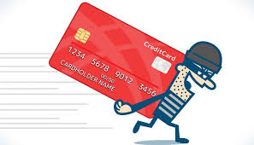

INTRODUCTION
Overview:
Fraud detection is essential for financial security.
Focused on detecting anomalies in credit card transactions.
Objectives:
Identify fraudulent transactions with high precision.
Leverage machine learning and data visualization techniques.

Slide 3
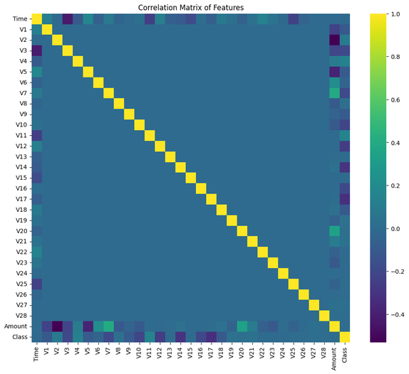
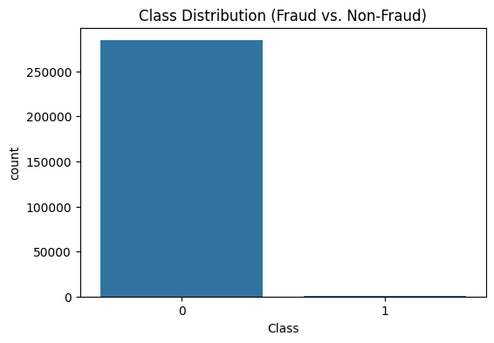
DATA EXPLORATION
Dataset Overview:
Total transactions: 284,807
Fraudulent transactions: ~492
Techniques Used:
Identifying null values and handling missing data.
Exploratory Data Analysis (EDA) for insights:
Class distribution.
Correlation matrix.
Outlier detection.
Visualization: Example heatmap and boxplot to show feature relationships.

Slide 4
METHODOLOGY
Data Preprocessing:
Addressed class imbalance using SMOTE.
Feature scaling with StandardScaler.
Machine Learning Models:
Random Forest: Utilized for its robustness and ability to handle overfitting with ensemble techniques.
Logistic Regression: Chosen for interpretability and effectiveness in binary classification.
Decision Trees: Employed for their simplicity and visual interpretability.
SVM: Leveraged with kernel tricks for handling non-linear decision boundaries.
XGBoost: Implemented for its speed, accuracy, and handling of complex data relationships.
Evaluation Metrics:
Accuracy, Precision, Recall, F1-score, AUC-ROC.

Slide 5
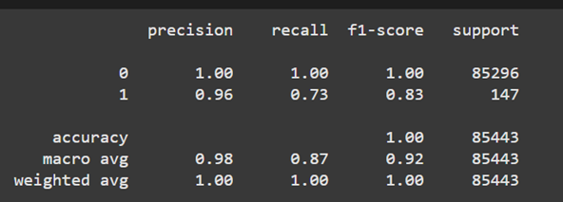
RESULTS
Model Performance:
Best Model: XGBoost with 96% accuracy.
Confusion Matrix and Classification Reports demonstrate minimal false positives and negatives.
Key Insights:
Fraudulent transactions often exhibit distinct patterns.
Feature "Amount" and time-related metrics play a critical role.

Slide 6
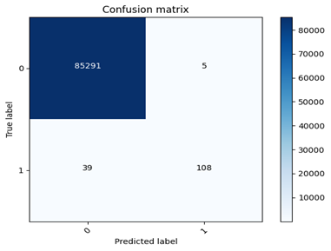

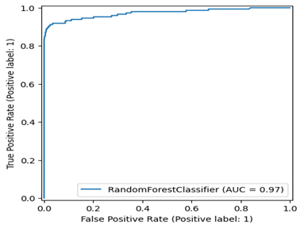
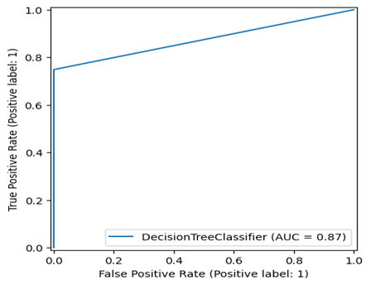
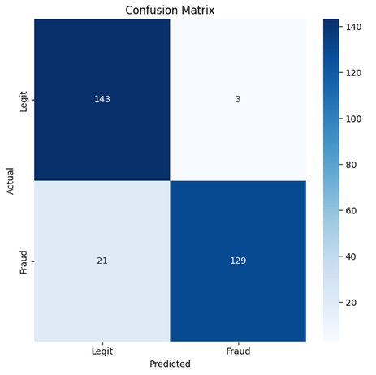

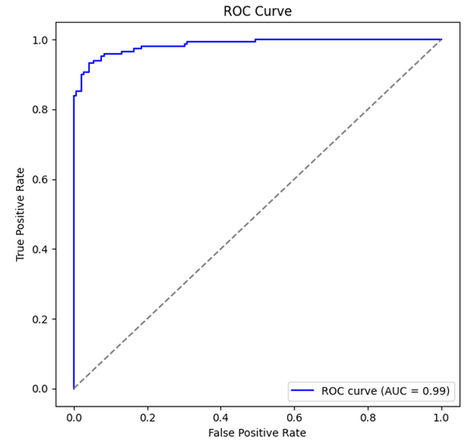
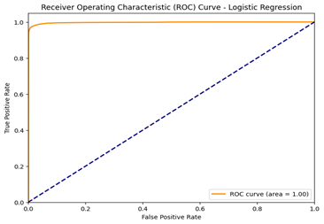
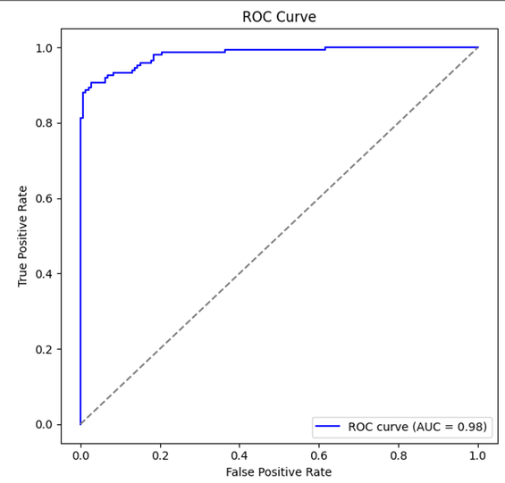

RESULTS

Slide 7
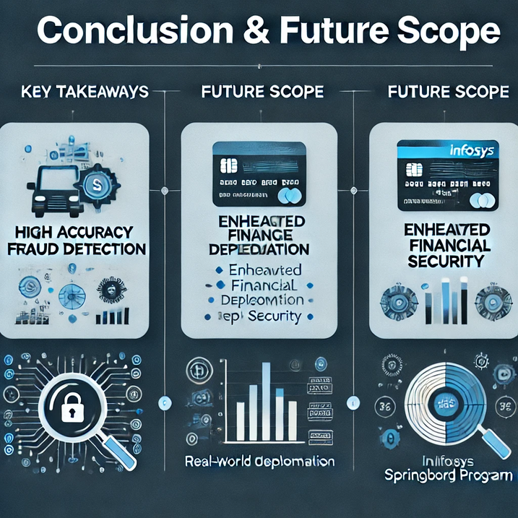
CONCLUSION & FUTURE SCOPE
Key Takeaways:
Efficiently detected fraud with high accuracy.
Enhanced financial security through robust models.
Future Scope:
Deployment of the model in real-world systems.
Further optimization with deep learning.
Acknowledgments:
Infosys Springboard Program for guidance and support.

Slide 8
THANK YOU

